Slide 1
Cornerstone City Church Peninsula Plus Community Hoo Are Ya
3rd August 2025

Slide 2


Slide 3
Blessed Jesus CCLI Song #
GKREAL
CCLI Licence No.

Slide 4
1/2
Blessed Jesus
We've come to give you praise
You are worthy
And Blessed be your name

Slide 5
2/2
We love you Lord
We love you Lord

Slide 6
Every Praise
CCLI Song # 6623483
Hezekiah Walker | John David Bratton
© 2013 Davo Pavo Music (Admin. by BMG Rights Management GmbH)
Li'l Eva Music (Admin. by Capitol CMG Publishing)
Luv Ki Publishing (Admin. by Capitol CMG Publishing)
For use solely with the SongSelect® Terms of Use. All rights reserved. www.ccli.com
CCLI Licence No. 33265

Slide 7
1/2
Every praise is to our God
Every word of worship with one accord
Every praise every praise is to our God
Sing hallelujah to our God
Glory hallelujah is due our God
Every praise every praise is to our God

Slide 8
2/2
God my Saviour
God my Healer
God my Deliverer
Yes He is yes He is
(Yes He is yes He is)

Slide 10
Way Maker CCLI Song # 7115744
Osinachi Kalu Okoro Egbu
© 2016 Integrity Music Europe (Admin. by Integrity Music)
For use solely with the SongSelect® Terms of Use. All rights reserved. www.ccli.com
CCLI Licence No. 33265

Slide 11
1/4
You are here moving in our midst I worship You I worship You You are here working in this place I worship You I worship You
(You are) Way Maker Miracle Worker Promise Keeper Light in the darkness my God that is who You are

Slide 12
2/4
You are here touching ev'ry heart I worship You I worship You You are here healing ev'ry heart I worship You I worship You
(You are) Way Maker Miracle Worker Promise Keeper Light in the darkness my God that is who You are

Slide 13
3/4
You are here turning lives around I worship You I worship You You are here mending ev'ry heart I worship You yeah I worship You Lord
(You are) Way Maker Miracle Worker Promise Keeper Light in the darkness my God that is who You are

Slide 14
4/4
That is who You are x4
Even when I don't see it You're working Even when I don't feel it You're working You never stop You never stop working x2

Slide 15
Here I am to Worship
CCLI Song # 3266032
Tim Hughes
© 2000 Thankyou Music (Admin. by Integrity Music Ltd)
For use solely with the SongSelect® Terms of Use. All rights reserved. www.ccli.com
CCLI Licence No. 33265

Slide 16
1/4
Light of the world
You stepped down into darkness
Opened my eyes let me see
Beauty that made
This heart adore You
Hope of a life spent with You

Slide 17
2/4
So here I am to worship
Here I am to bow down
Here I am to say that You're my God
And You're altogether lovely
Altogether worthy
Altogether wonderful to me

Slide 18
3/4
King of all days
Oh so highly exalted
Glorious in heaven above
Humbly You came
To the earth You created
All for love's sake became poor

Slide 19
4/4
And I'll never know how much it cost
To see my sin upon that cross
And I'll never know how much it cost
To see my sin upon that cross

Slide 21
Holy Forever
CCLI Song # 7201044
Brian Johnson | Chris Tomlin | Jason Ingram | Jenn Johnson | Phil Wickham
© Phil Wickham Music (Admin. by / Small Stone Media BV, Holland (Admin. in the UK/Eire by Song Solutions www.songsolutions.org))
Simply Global Songs (Admin. by / Small Stone Media BV, Holland (Admin. in the UK/Eire by Song Solutions www.songsolutions.org))
Capitol CMG Paragon (Admin. by Capitol CMG Publishing)
S. D. G. Publishing (Admin. by Capitol CMG Publishing)
Be Essential Songs (Admin. by Essential Music Publishing LLC)
My Magnolia Music (Admin. by Essential Music Publishing LLC)
Bethel Music Publishing (Admin. by Song Solutions)
Brian and Jenn Publishing (Admin. by Song Solutions)
For use solely with the SongSelect® Terms of Use. All rights reserved. www.ccli.com
CCLI Licence No. 33265

Slide 22
1/10
A thousand generations falling down in worship
To sing the song of ages to the Lamb
And all who've gone before us
And all who will believe
Will sing the song of ages to the Lamb

Slide 23
2/10
(Jesus) Your name is the highest
Your name is the greatest
Your name stands above them all
All thrones and dominions
All powers and positions
Your name stands above them all

Slide 24
3/10
And the angels cry Holy
All creation cries Holy
You are lifted high Holy
Holy forever

Slide 25
4/10
If you've been forgiven and if you've been redeemed
Sing the song forever to the Lamb
If you walk in freedom and if you bear His name
Sing the song forever to the Lamb
We'll sing the song forever and amen

Slide 26
5/10
And the angels cry Holy
All creation cries Holy
You are lifted high Holy
Holy forever

Slide 27
6/10
Hear Your people sing Holy
To the King of Kings Holy
You will always be Holy
Holy forever

Slide 28
7/10
(Jesus) Your name is the highest
Your name is the greatest
Your name stands above them all
All thrones and dominions
All powers and positions
Your name stands above them all

Slide 29
8/10
And the angels cry Holy
All creation cries Holy
You are lifted high Holy
Holy forever

Slide 30
9/10
Hear Your people sing Holy
To the King of Kings Holy
You will always be Holy
Holy forever

Slide 31
10/10
You will always be Holy
Holy forever

Slide 32


Slide 33
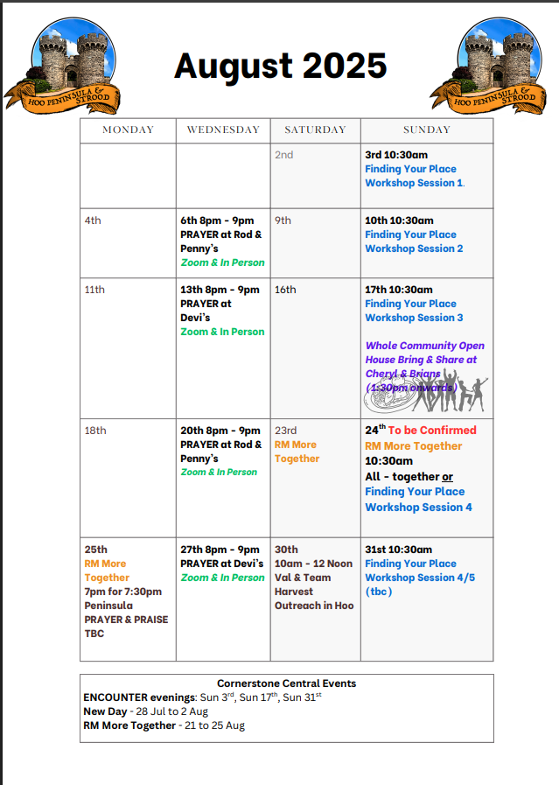

Slide 34


PPP God Whispers

Slide 35


Slide 36

Grow Group 1
On YOUR MARK!

Slide 37
Leaders
Leaderss
Phil & Kim
Maria (Mia) Warren
Matthew Harrison
Richard & Elisha Acheampong
Phil & Kim
Maria (Mia) Warren
Matthew Harrison
Richard & Elisa Acheampong

Slide 38

Storm Walker
Storm Walker
Symbolising, trust in Jesus Christ through life's storms.
Mark 4:35-41

Slide 39



Group Leaders
Micheal and Mwamba
Wilfred and Parveen
Hannah

Slide 40


Slide 41


Slide 42


Slide 43
2 Corinthians 14 May the grace of the Lord Jesus Christ, and the love of God, and the fellowship of the Holy Spirit be with you all
Surely goodness and mercy shall follow us all the days of our lives, and we shall dwell in the house of the Lord forever.

